Slide 1

By Rohit Kumar
Business Analyst Career Program - Capstone Project

Slide 2

Agenda
Data Exploration
Statistical Analysis using Excel
Graphical Analysis using Excel
Insert the given data into the SQL server
Import the Data from the SQL Database into PowerBI
Interactive Dashboard by using visualization tools
Conclusion and Inferences
Endnotes

Slide 3
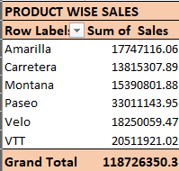
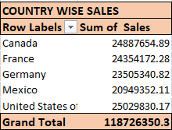
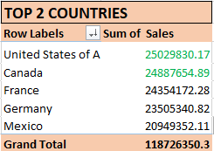
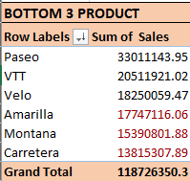
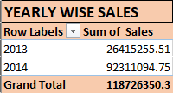
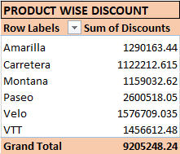
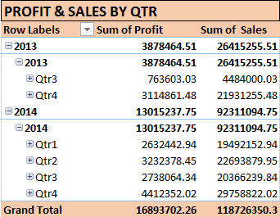
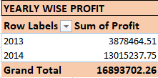
Data Exploration

Slide 4
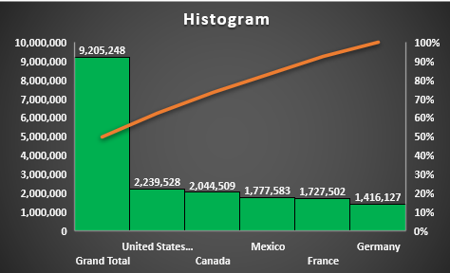
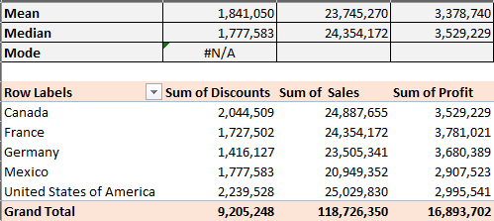
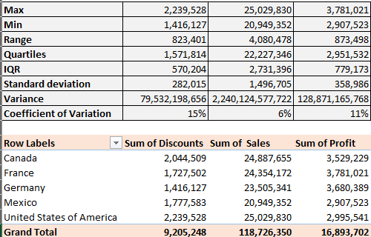
Statistical Analysis using Excel

Slide 5
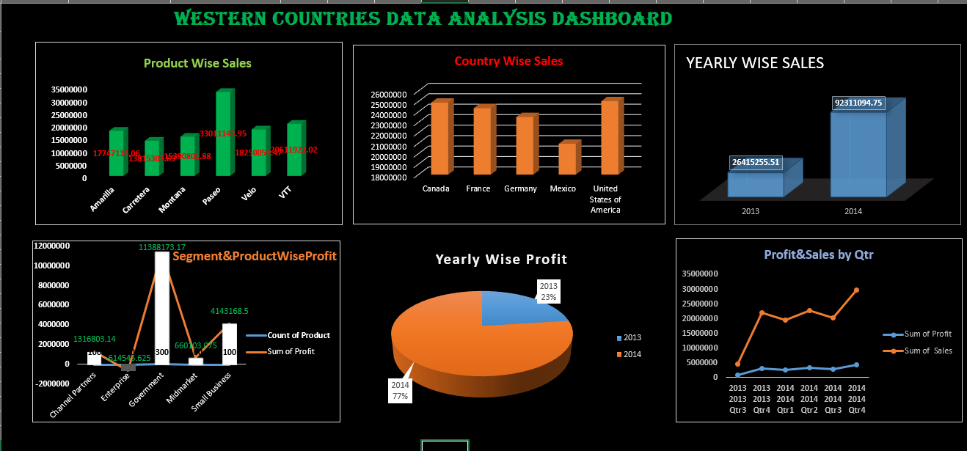
Graphical Analysis using Excel

Slide 6
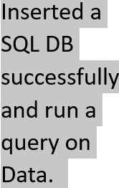
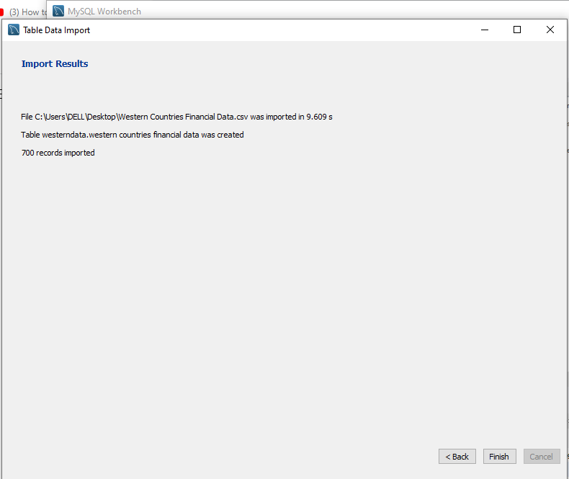
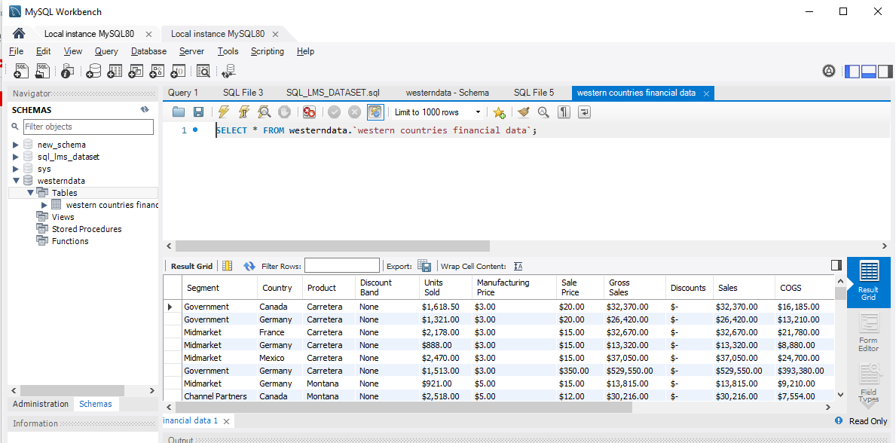
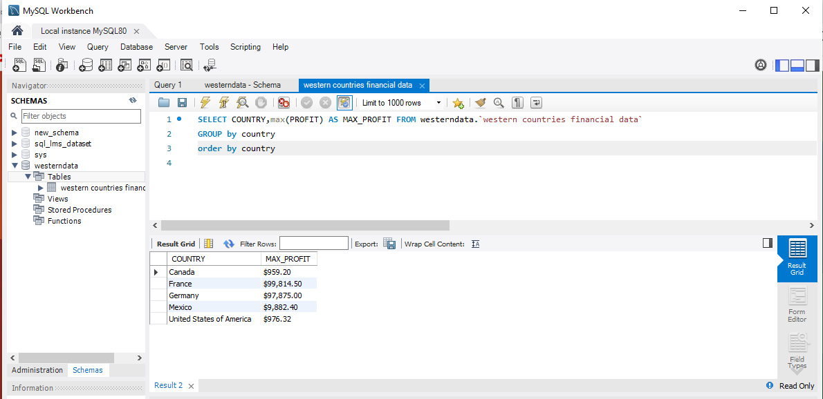
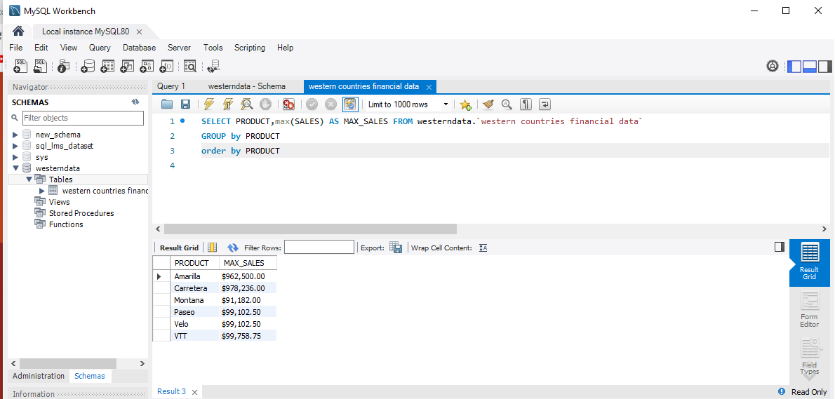
Insert the given data into the SQL server

Slide 7
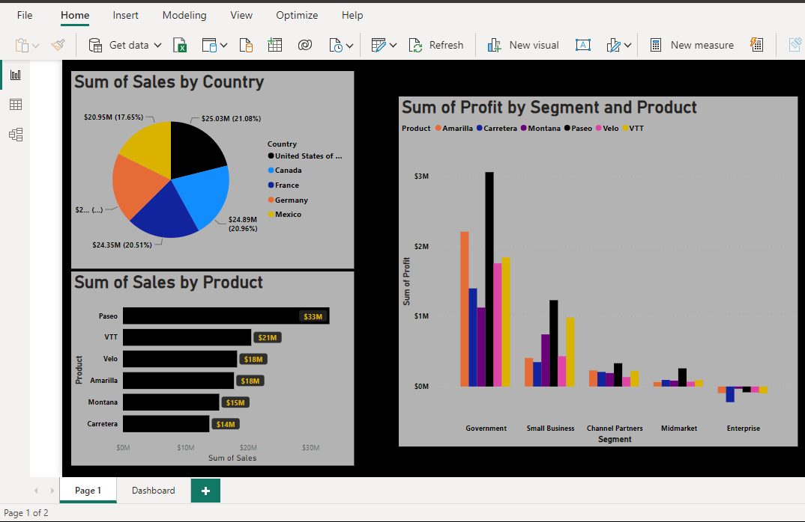
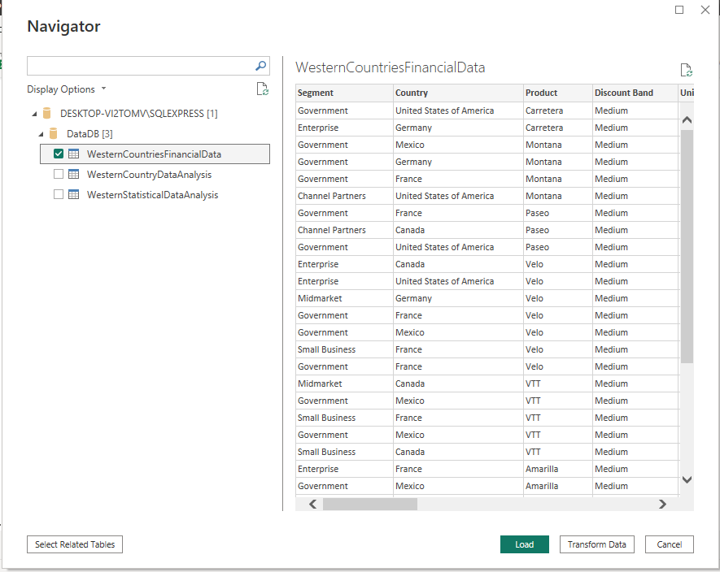
Import the Data from the SQL Database into PowerBI

Slide 8
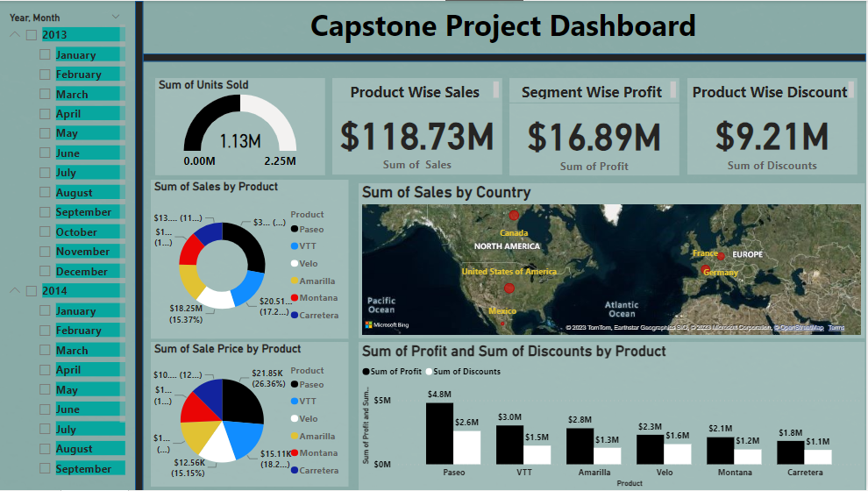
Interactive Dashboard by using visualization tools

Slide 9
Conclusion and Inferences
Conclusion:
Statistical and graphical analysis of financial data using Excel and visualization tools like Power BI provides valuable insights into financial performance.
The analysis helps identify trends, patterns, and variations in financial indicators, aiding in decision-making and forecasting.
Data integrity and accuracy are ensured through data validation and error checking mechanisms.
Interactive visualization tools enhance the analysis process and facilitate deeper insights into financial data.
Inferences:
Performance drivers can be identified, enabling stakeholders to optimize financial outcomes.
Financial risks can be assessed by examining key indicators and trends within the data.
Financial planning and forecasting can be improved by leveraging historical patterns and relationships.
Key performance indicators (KPIs) can be identified for monitoring and measuring financial performance.
Effective communication of financial insights is facilitated through graphical representations of the data.

Slide 10
Endnotes
Reference Links:-
Western Countries Financial Data-: Excel file
Capstone Project-: PowerBI file
Endnotes:
Statistical analysis using Excel allows for data exploration, trend identification, and calculation of key
financial metrics.
2. Graphical analysis in Excel enhances data visualization, aiding in the identification of patterns, outliers,
and relationships within financial data.
3. Power BI provides interactive dashboards and visualization tools that enable users to drill down into
specific data points and apply filters for deeper analysis.

